Slide 1


State Mask Mandate Analysis
Presented by Adam Curry
Bellevue University DSC680 – Applied Data Science

Slide 2
Presentation Format
Domain – What domain is this data going to come from?
Data Used – Where did the data come from? What variables were used?
Research Questions – What questions will be answered from this analysis?
Data Prep – What was the data preparation process?
Methods – What methods were used?
Findings – What did the analysis reveal?
Conclusion – What’s next?

Slide 3
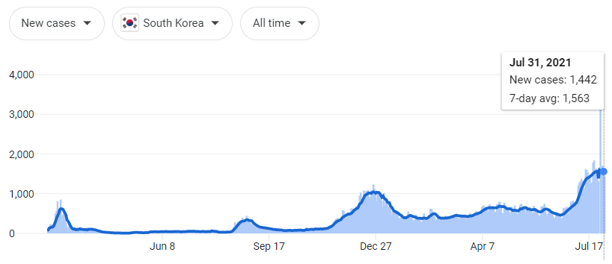
Domain
Masking to slow the spread of covid
South Korea was the model to keep cases at bay
South Korea’s cases are on the rise
States are conflicted about mask mandates
https://www.google.com/search?q=south+korea+covid+cases&rlz=1C1CHBF_enUS850US886&oq=south+korea+covid+cases&aqs=chrome..69i57j0i131i433i457i512j0i512l8.4502j0j4&sourceid=chrome&ie=UTF-8
Notes:
In February 2020, if you told me I’d be wearing a mask to go grocery shopping, I would’ve laughed. However, as soon as the pandemic hit, I quickly realized this may be a necessary move to help slow the spread of coronavirus
I saw South Korea come out with masking mandates, which seemed to lead to fewer cases. I was on board with masking, as this appeared to be an indicator that masks worked.
Today, South Korea is still masking indoors, and noncompliance can lead to fines [1][2]. Yet they have seen case spikes higher than any point in this pandemic within recent months
If masks are how we slow the spread, what is happening in these other countries that are seeing sudden spikes? This analysis will focus on the Unites States and the various mask policies implemented at the state level.
The purpose isn’t to uncover if masks work or not, rather to show the effectiveness of mandating them at the state level. Some claim that certain states followed the science based on mask mandates, and with the recent surge in COVID cases related to the delta variant, there have been new calls for mask mandates [3][4]. Are these calls warranted and are they being made as a result of empirical evidence?

Slide 4
Research Questions
What states have the most stringent masking policies?
What states have the least stringent masking policies?
Did statewide policies make a difference in suppressing covid case counts?
Can covid case predictions be made based on masking policies?

Slide 5
Data Used
Collected by Oxford
H6_Facial Coverings and ConfirmedCases
0-4 Odinal scale for masking policies
Notes:
The data is collected by Oxford university and contains a robust data dictionary with a historical record of cumulative cases and “facial covering” policies
There are a wide variety of other metrics, even a stringency index that shows how governments responded to the virus, but the one two I was interested in were: H6_Facial Coverings and ConfirmedCases
0 – meant there were no mask policies
1 – meant masks were merely recommended
2 – meant that masks were required in some specified shared/public spaces outside the home with other people present, or some situations when social distancing not possible
3 – meant masks were required in all shared/public spaces outside the home with other people present and/or all situations when social distancing was not possible
4 – meant that masks were required outside the home at all times regardless of location or presence of other people

Slide 6
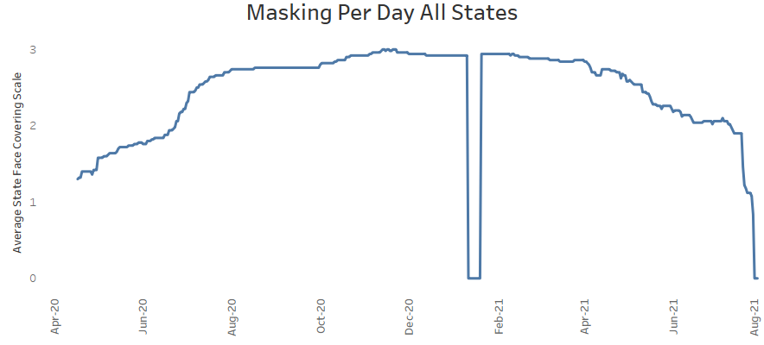
Data Prep
Gaps in masking reporting fixed with imputed values
Updated cumulative cases to daily cases
Basic case statements to show masking (>scale 2)
Notes:
Looking for data discrepancies, I found that there was a massive gap in the facial covering metric. This doesn’t make logical sense, as January 2020 was the peak pandemic within the states. To alleviate this gap, I imputed the mode of all ordinal values for the month of January.
I also noticed that the covid case column was cumulative case counts, which isn’t helpful when looking for correlation and daily case distribution over a timeline. To mitigate this, I partitioned the data by state, ordered by date, and subtracted the record from the prior record.
I also created a binary indicator for masks. If the scale was greater than 2, meaning masks were required in all shared/public spaces outside the home with other people present and/or all situations when social distancing was not possible, then I assigned a 1 else 0.

Slide 7
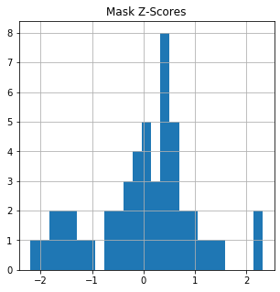
Methods
Found the least stringent and most stringent masking states using ordinal masking metric.
Created two separate datasets for exploratory data analysis
Made predictions on case counts
Notes:
To find the least stringent and most stringent states, I utilized the face coverings metric (ordinal metric). I added up the total number of days with a mask mandate, and the associated 0-4 mask scale.
Then, I created two separate datasets, one for the high masked states and one for the low masked states. And did some basic EDA with correlation heatmaps, scatter plots, and regression analysis.
The final method was to make predictions on covid case counts based on masking policy alone. I did this using a support vector machine model, decision tree model, and a random forest model.

Slide 8
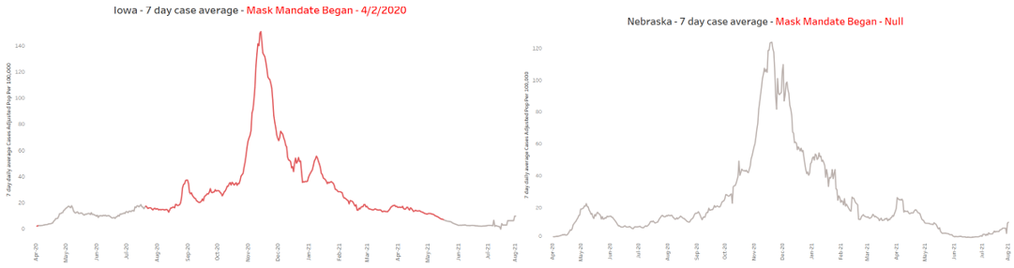
Findings 1 of 3
What states have the most stringent masking policies? North Carolina and Massachusetts had the most stringent policies
What states have the least stringent masking policies? Nebraska, Minnesota, and Georgia had the least stringent policies
Did statewide policies make a difference in suppressing covid case counts? We can't reject the null hypothesis – state mask mandates don't stop the spread of covid cases
Notes:
Hypothesis Question # 1 - What states have the most stringent masking policies? North Carolina and Massachusetts had the highest 0-4 scale per month than any other state. However, New York had the most months that required a mask. Remember, some states required masks outdoors, even when nobody was around (scale 4). These mask policies pushed North Carolina and Massachusetts above the rest.
Hypothesis Question # 2 - What states have the least stringent masking policies?
Nebraska, Minnesota, and Georgia had the lowest 0-4 scale per month than any other state. However, South Dakota and Wyoming also never had a mask mandate. Remember, some states “recommended” masks (scale 1), which added to the totals.
Hypothesis Question # 3 - Did statewide policies make a difference in suppressing covid case counts?
Correlation heatmaps and scatter plots show that the more months that required masks, the higher the cases were. Showing neighboring states shows that states with a mask mandate have the exact same curve and case counts as those without mandates. Looking at Nebraska and Iowa’s seven day moving case average, adjusted for population, shows near identical movement and case counts. The same can be seen for other states Minnesota compared to Michigan, Georgia compared to North Carolina [Appendix D of white papaer]. Regression analysis yields a relatively low R² where the highest was at .28 (on high masked states) and the at lowest .1 (low masked states). All p-values are statistically insignificant ranging from 0.161 to 0.674. This seems to indicate that state mask mandates account for little variance in covid cases.

Slide 9
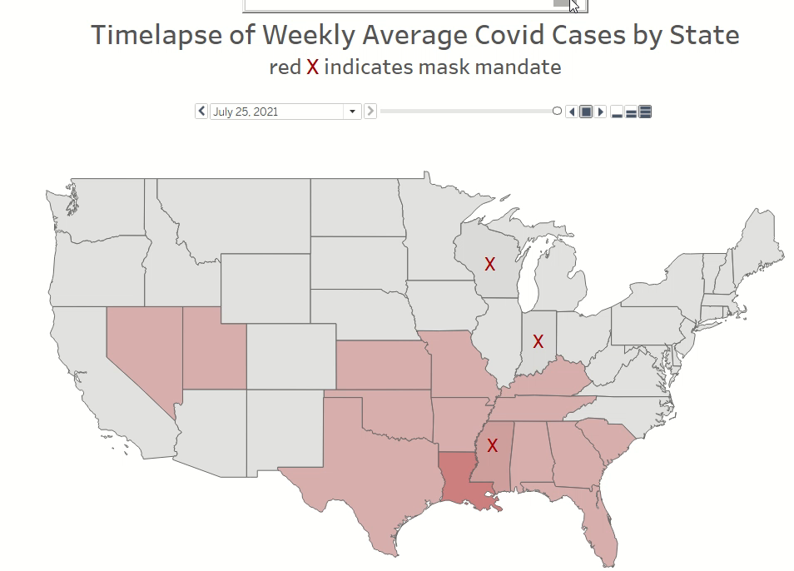
Findings 2 of 3
Notes:
To illustrate masking policies across the country, I created a time laps of all states (minus Alaska and Hawaii), showing weekly cases aggregations in red, and a red X for weeks a mask mandate was implemented. I’ve sped this up for the sake of time, but the full workbook is in the Github repository.

Slide 10
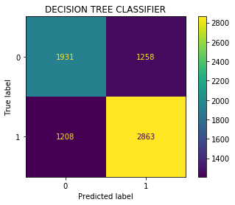
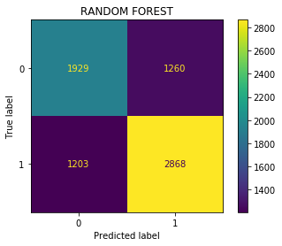
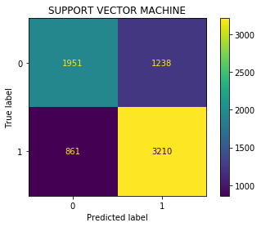
Findings 3 of 3
Can covid case predictions be made based on masking policies?
Yielded pretty accurate findings
Potentially misleading
Notes:
Hypothesis Question # 4 - Can covid case predictions be made based on masking policies?
The final step was to predict masking policies based on covid cases. I did this with the entire population of states and yielded pretty good results. The Support Vector Machine yielded 71% accuracy, Decision Tree 66% accuracy, and Random Forest 66% accuracy. However, these results are very misleading. The trend analysis showed that states tended to implement mask mandates as cases were rising, while removing mandates once they were descending. Unless there are more control states, i.e. states that didn’t have mandates, then these predictions will be easy to make.

Slide 11
Conclusions
Statewide mask mandates don’t appear to slow the spread of covid
Analysis of masking children and/or school mandates
Notes:
These data don’t support the theory that statewide mask mandates slow the spread of covid. This is not an assertion that masks don’t work. This is just highlighting that everyday mask usage mandated by the state, yield little to no correlation of slowing the spread of covid cases.
I’d also like to do a full analysis on the spread within schools. Many studies and analyses have shown that children don’t get nearly as sick and are not the vectors of the disease [8][9][10][11][12]. I would like to conduct a similar analysis of covid cases within schools.

Slide 12
Questions
Could this same method be applied at a more granular geographical level?
You stated that the decision tree and random forest models had a decent prediction level, could this be an indicator that masks work?
How would you alleviate the masking policy discrepancy in Texas compared to California?
What were some of the correlation metrics that you noticed?
Is a statewide mandate the best way to test if masks work or not?
Could the droplets that masks stop have an impact on covid case numbers?
Do you have plans to refresh the dataset with updated case counts and mask numbers?
Why did you focus on 6 states in your neighboring state comparison?
Is this an oversimplification of masking policies?
Did you review hospitalizations and or deaths?
Notes:
Could this same method be applied at a more granular geographical level? Yes, I think it could. The problem is time and finding a reliable source.
You stated that the decision tree and random forest models had a decent prediction level, could this be an indicator that masks work? I don’t think so. Rerunning this now that cases are on the rise might be a better barometer. For example, at the beginning of the pandemic, state governments did what they thought best. However, now that more states are not implementing mandates with the rise of cases, it’ll be interesting to see how that impacts statewide case rates.
How would you alleviate the masking policy discrepancy in Texas compared to California? I think it would require manually entering indicators. However, I need to make the assumption that this is a metric that has specific parameters defined by Oxford. Therefore, I proceeded with my analysis.
What are some of the correlation metrics that you noticed? Correlation heatmaps in the high mask population show that there is a .45 positive correlation with masking outside and a -.25 negative correlation when masking at scale 2 (required in some specified shared/public spaces outside the home with other people present). For the low mask rate there is a .22 positive correlation with masking scale 2 and a .14 negative correlation when masking is recommended
Is a statewide mandate the best way to test if masks work or not? no. This study focuses on statewide mandates, not controlled environments. Masks may work within a lab setting or in close proximity with other individuals, but mandating at the state level doesn’t appear to work.
Could the droplets that masks sopped have an impact on covid case numbers? I don’t think so, there are other studies that have proven the virus is airborne. But this analysis didn’t focus on properly work masks or types of masks, rather just the actual state mandated effectiveness.
Do you have plans to refresh the dataset with updated case counts and mask numbers? Yes, I will wait until the month of August subsides and perhaps do a monthly refresh.
Why did you focus on 6 states in your neighboring state comparison? I only focused on states that didn’t have a mandate versus those that had a mandate. For the sake of time, I only chose one neighboring state.
Is this an oversimplification of masking policies? It could be. But I don’t know what other variables would be good indicators of COVID case suppression. Since masking is such a politized subject, it seemed appropriate.
Did you review hospitalizations and or deaths? I did not. I wanted to focus solely on case counts.

